Slide 1

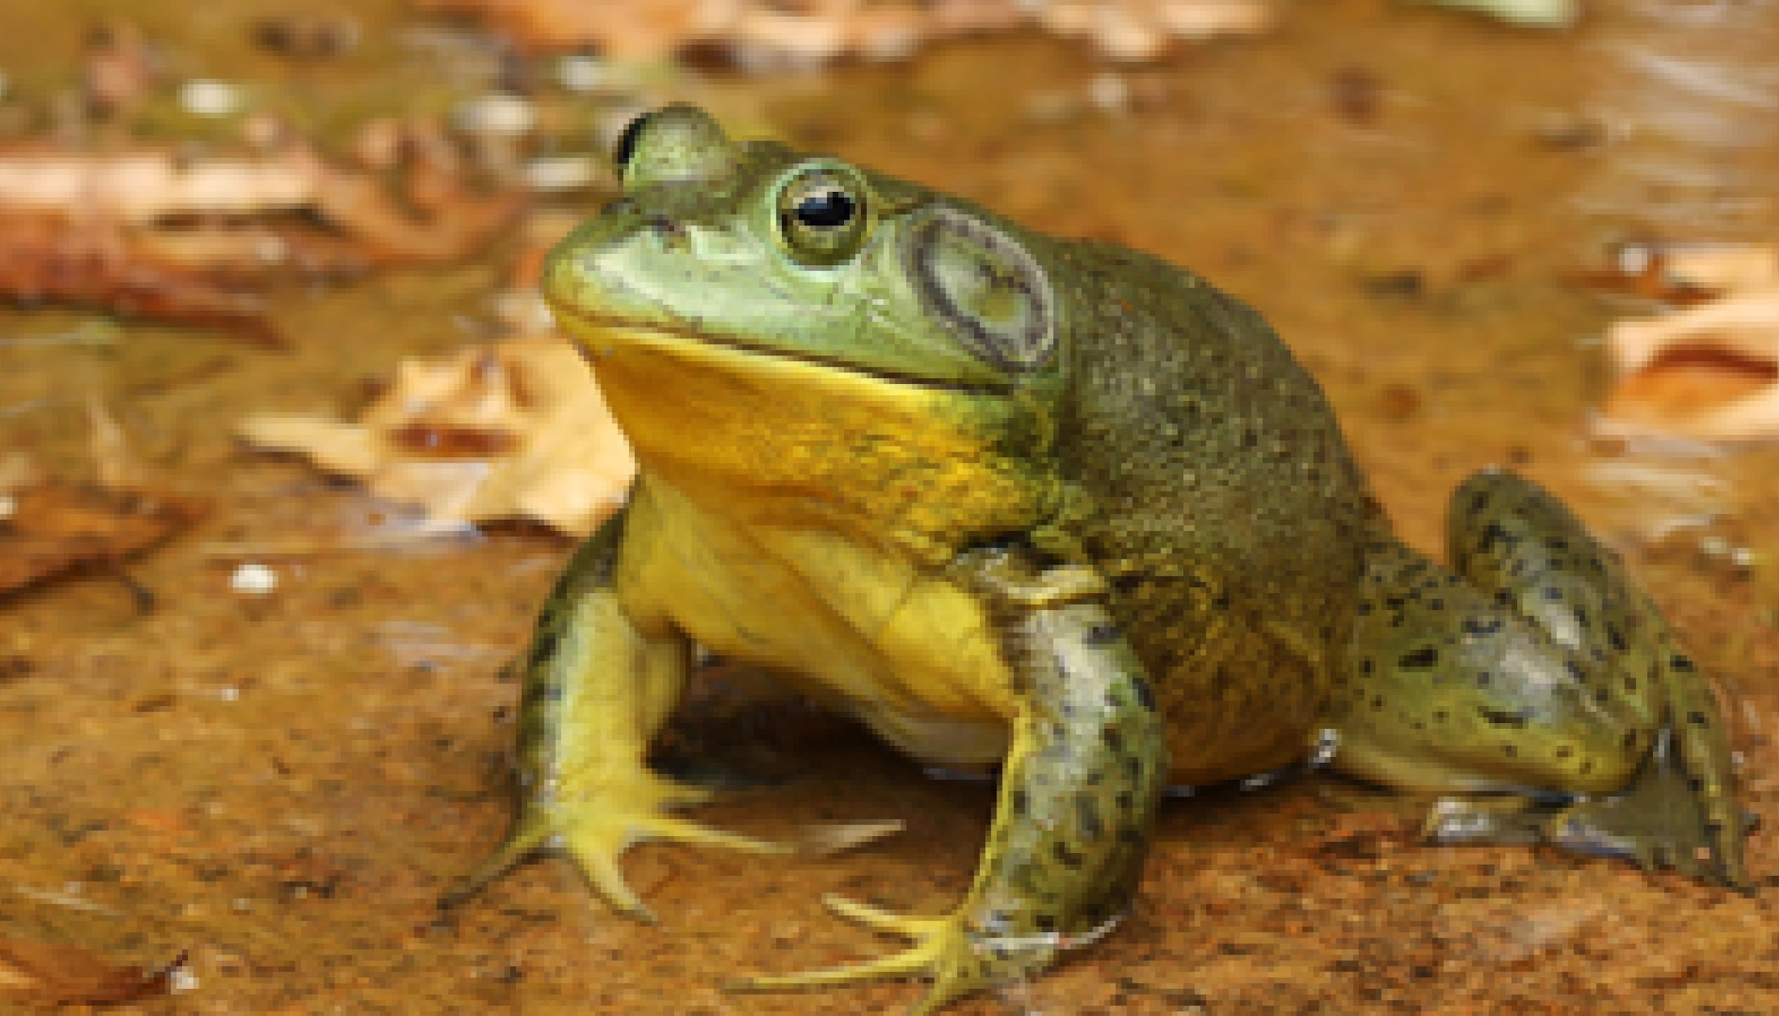
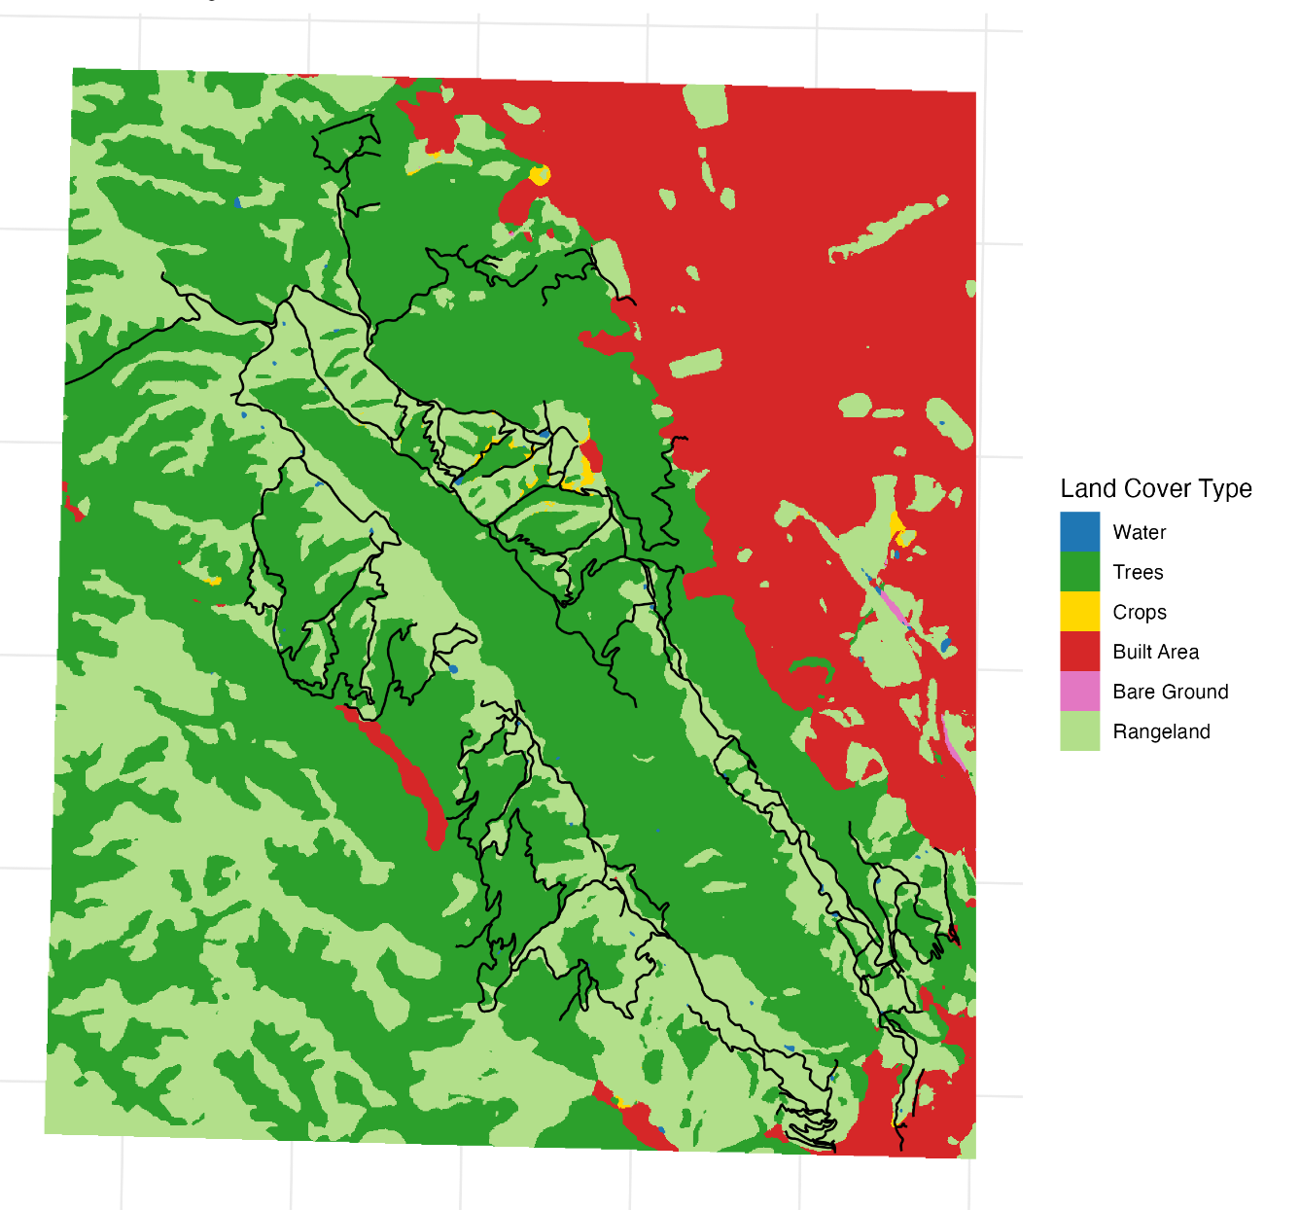
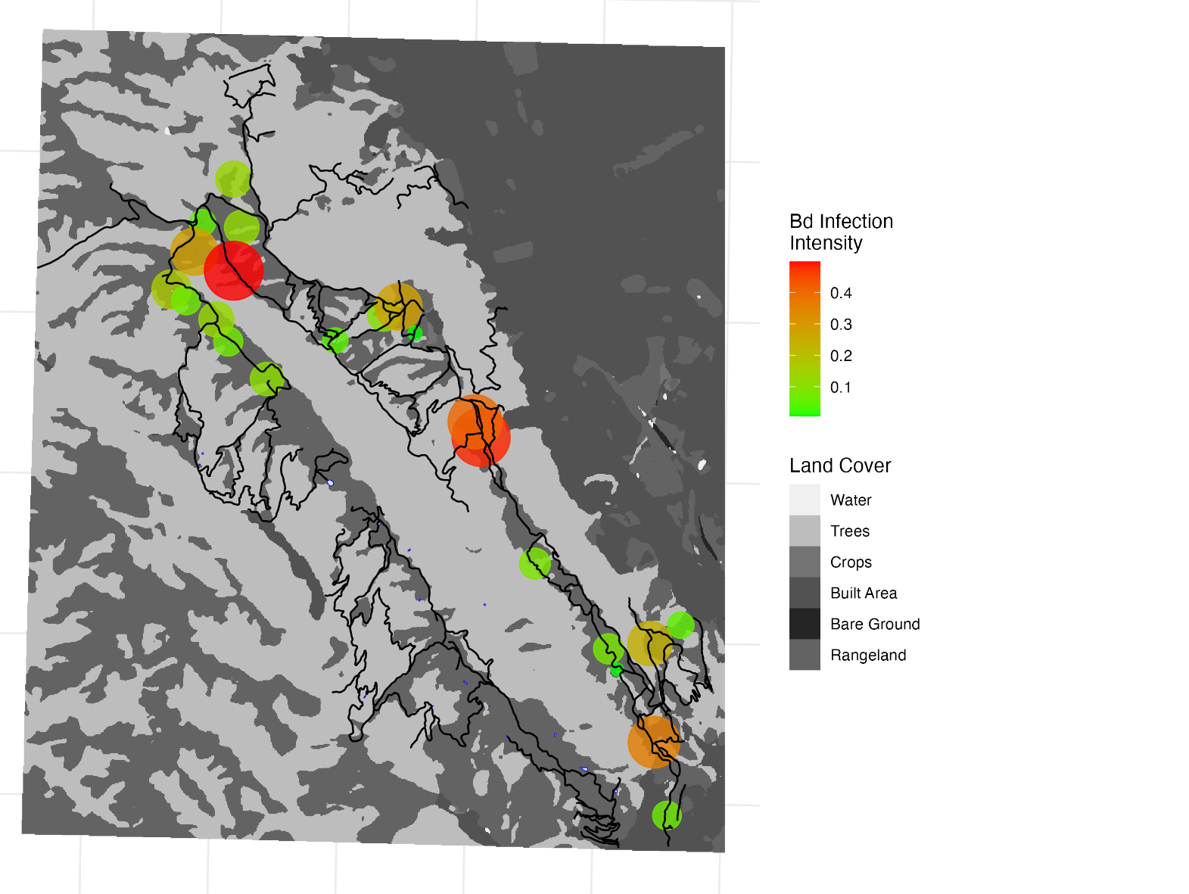
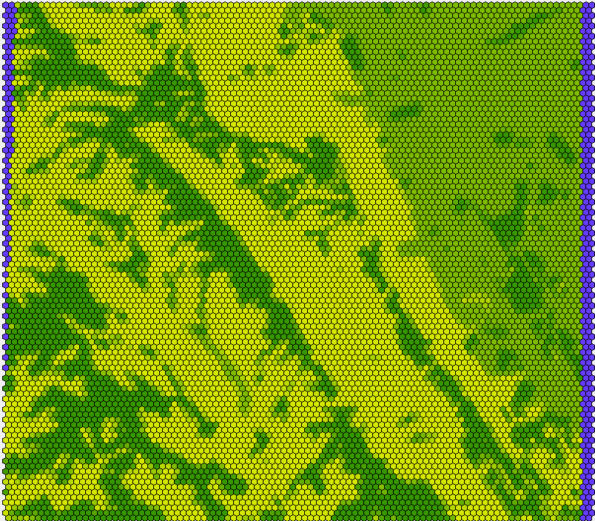
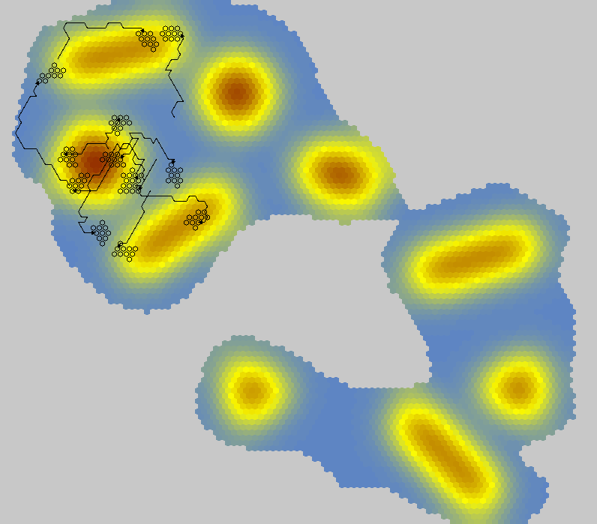

Pixelating Persistence: A Spatially Explicit View of Bullfrog Dynamics
Pratyush S. Rallapally¹, Kacie Ring¹, Cherie J. Briggs¹
¹ University of California, Santa Barbara
Introduction
Model
Future Directions
Native amphibian species in California are declining rapidly with American bullfrogs (rana catesbeiana) acting as a major driver
Current management strategies are often ineffective, limited by high costs, time demands, and logistical constraints.
Simulation modeling offers a promising alternative, and is becoming increasingly accessible in ecological research
Life Cycle Events
Population Traits
Spatial Data
Time Series
Evaluating the effectiveness of management strategies simulated within HexSim
Collection of bullfrogs is biased; must predict bullfrog population sizes to more accurately calculate impact on Bd transmission
Simulate individuals within a branching network system instead of a spatial grid
Can evaluate connectivity metrics of different ponds within region
HexSim Model Engine
Census Data
Simulation Viewer
Report Generator
Results
Conclusions
HexSim is a powerful tool for simulating demographics, movement, and spatial patterns for any organism/region
- Our model reveals bullfrog population hotspots, ideal for more precise interventions
Simulation modeling enhances understanding of bullfrog persistence and spread, and can inspire more effective invasive species management strategies
Original Map
Infectivity Prediction Map
Goal: Use HexSim to develop a spatially explicit, individual-based model to simulate bullfrog dynamics within Pleasanton Ridge Regional Park.
Potential Uses
Population
Long-term population data is sparse and our bullfrog population studies are opportunistic; simulation modeling allows for a more targeted/accurate approach
Original Map (in HexSim)
Movement Prediction Map
References + Acknowledgements
Special Thanks to:
Nathan Schumaker
Tammy Lim, East Bay Regional Park District
Briggs Lab
Disease
Population trajectories can identify likely infection hot spots
Predict disease dynamics of Batrachochytrium dendrobatidis (Bd)
Schumaker, N.H., Brookes, A. HexSim: a modeling environment for ecology and conservation. Landscape Ecol 33, 197–211 (2018). https://doi.org/10.1007/s10980-017-0605-9
Currie, W., & Bellis, E. D. (1969). Home range and movements of the bullfrog, Rana catesbeiana Shaw, in an Ontario pond. Copeia, 1969(4), 688–692.
Notes:
why is the collection biased? (surveys were day surveys → bullfrogs are nocturnal)
current strategies: culling specific stages, fencing, guns (chec virToad paper)

